Slide 1
Data Science as a Career

Slide 2

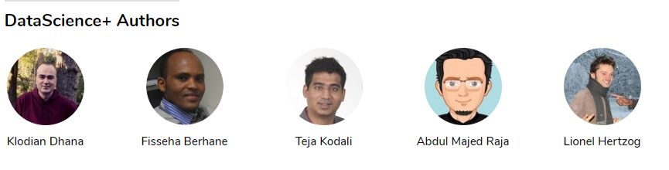



About Me!
Abdul Majed Raja
6+ Yrs

Slide 3
Focus!
“People think focus means saying yes to the thing you've got to focus on. But that's not what it means at all. It means saying no to the hundred other good ideas that there are. You have to pick carefully. ”
Steve Jobs

Slide 4
Divider slide heading 32pt Vodafone Bold
The start!

Slide 5

This happened!

Slide 6
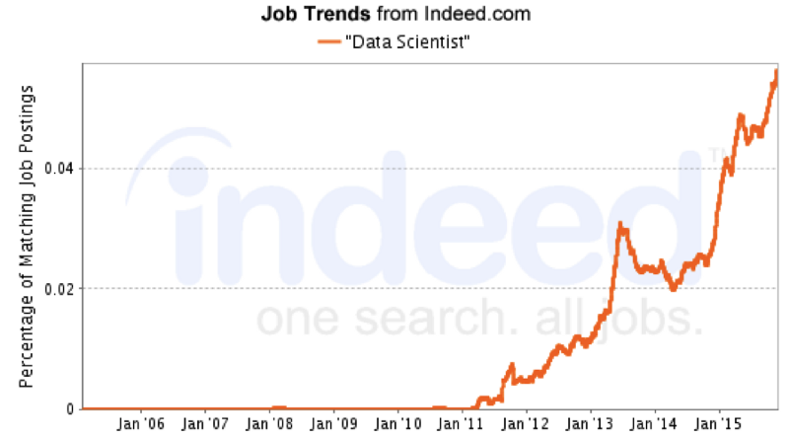
Then this happened!

Slide 7

Interested - Let’s jump in the ship!!

Slide 8
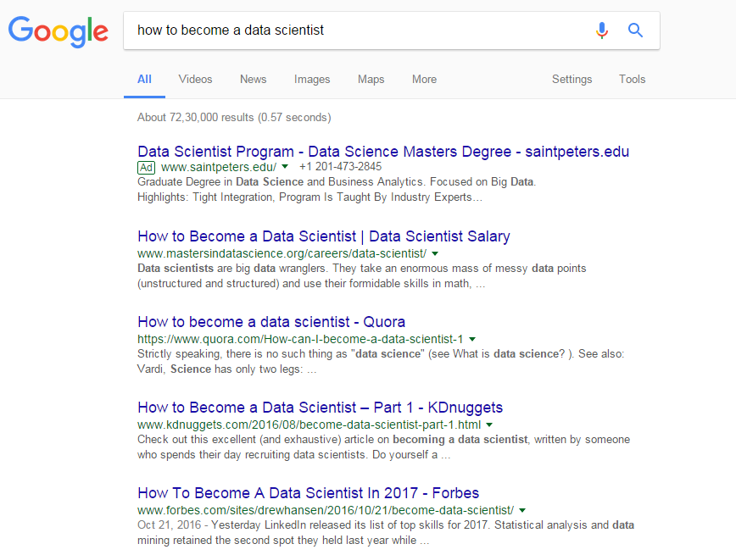
Ask Google!

Slide 9

Opinions!
Guide to become Data Scientist!
BootCamps
Paid Courses

Slide 10


The Versus Game!

Slide 11

Finally!

Slide 12
Brick Walls!
“The brick walls are there for a reason.
The brick walls are not there to keep us out.
The brick walls are there to give us a chance to show how badly we want something.
Because the brick walls are there to stop the people who don’t want it badly enough. They’re there to stop the other people.”
The Last Lecture , Randy Pausch

Slide 13
Divider slide heading 32pt Vodafone Bold
Introduction
to
Data Science!

Slide 14
Data Science – Synonyms
Machine Learning
Data Mining
Advanced Analytics
Data Analytics
Business Analytics
Artificial Intelligence
Deep Learning

Slide 15

find.what(‘Data Science’)
http://drewconway.com/

Slide 16
Hacking:
To play with Data :
Data Collection – Web Scraping
Data Cleaning & Processing
Code Optimization
Model Deployment

Slide 17
Math & Statistics:
Understanding Statistics, Probability, Econometrics:
What Machine learning Technique to use?
How to evaluate and validate different modeling strategies?
How to design Randomized Experiments?

Slide 18
Substance:
Business / Domain/ Market Knowledge :
How to help business ask the right analytics question?
How to present the outcome of the analysis?
How to estimate the value?

Slide 19
Divider slide heading 32pt Vodafone Bold
Data Science
Workflow

Slide 20

Data Science - Scenario #1:

Slide 21






Data Science – Scenario #2
4
Data Visualization
3
Data Manipulation
2
Data Cleaning
1
Data Collection

Slide 22
Divider slide heading 32pt Vodafone Bold
“Analysis is Worthless
if you don’t
Communicate it”

Slide 23
Communication
State | 2001 | 2011
Andhra Pradesh | 978 | 992
Arunachal Pradesh | 893 | 920
Assam | 935 | 954
Bihar | 919 | 916
Chhattisgarh | 989 | 991
Goa | 961 | 968
Gujarat | 920 | 918
Haryana | 861 | 877
Himachal Pradesh | 968 | 974
Jammu & Kashmir | 892 | 883
Jharkhand | 941 | 947
Karnataka | 965 | 968
Kerala | 1058 | 1084
Madhya Pradesh | 919 | 930
State | 2001 | 2011
Maharashtra | 922 | 925
Manipur | 978 | 987
Meghalaya | 972 | 986
Mizoram | 935 | 975
Nagaland | 900 | 931
Odisha | 972 | 978
Punjab | 876 | 893
Rajasthan | 921 | 926
Sikkim | 875 | 889
Tamil Nadu | 987 | 995
Tripura | 948 | 961
Uttar Pradesh | 898 | 908
Uttarakhand | 962 | 963
West Bengal | 934 | 947
NITI Aayog: Sex Ratio (Females/ 1000 Males)

Slide 24
Data Visualization

Slide 25
Divider slide heading 32pt Vodafone Bold
Minimalistic
Learning
Path

Slide 26
Complete Newbie
Pick a Language — R /Python
Basics of the language — Data Types, Loops, Conditions, Functions
Beginning of Data Analysis
Data Visualization
Machine Learning begins - Statistics
Machine Learning Rises – Building Models
Entry-Level Data Scientist

Slide 27
Complete Newbie
Find a Mentor (online or offline)
Prepare with a group/team or at least a partner
Don’t waste a single paisa for courses (except Internet charges cost)
Attend Meetups and Conferences
Read, Listen, Read, Read – Blogs, Podcasts, Whitepapers, Books
Entry-Level Data Scientist

Slide 28

Learn!

Slide 29






Py
Data Science

Slide 30
Produce!
“If you don’t produce, you won’t thrive—no matter how skilled or talented you are.”
Deep Work, Cal Newport

Slide 31
Display!
Github – Own Repos, Contributions
Competitions/Hackathons – Kaggle, Crowdanalytix, Analytics Vidhya Hackathon
Blog posts – Medium, Wordpress, Github
Meetups/Conferences

Slide 32
Divider slide heading 32pt Vodafone Bold
Beyond
Data Science

Slide 33




Improve Thinking!

Slide 34







Code {Projects}
Showcase!
Design
{UI, UX, Art, Logo}
Write
{Blog/Books}
Publish
{Podcast/Videos}
Build & Sell
{Kits/Products}

Slide 35




Get in Touch!
@amrrs
@amrwrites
amr.rs.contact@gmail.com
https://in.linkedin.com/in/amrrs

Slide 36
Thanks!

